Slide 1
Putting the NIZ in perspective
May 2012

Slide 2
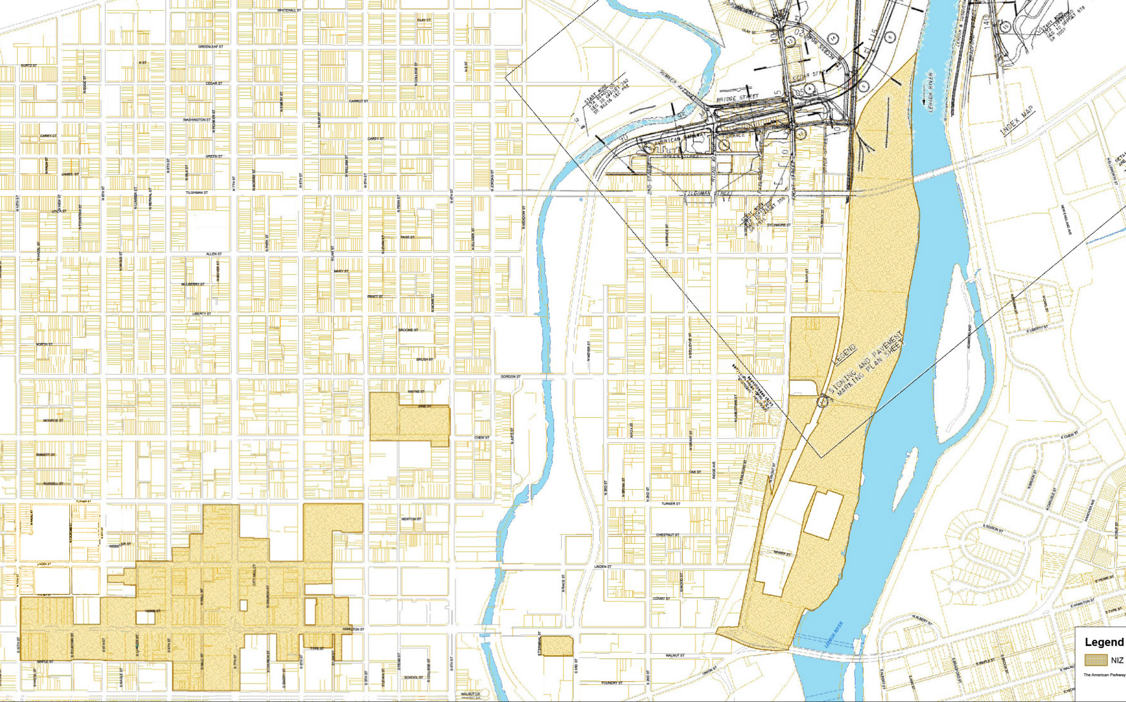
Map of ALLENTOWN niz

Slide 3
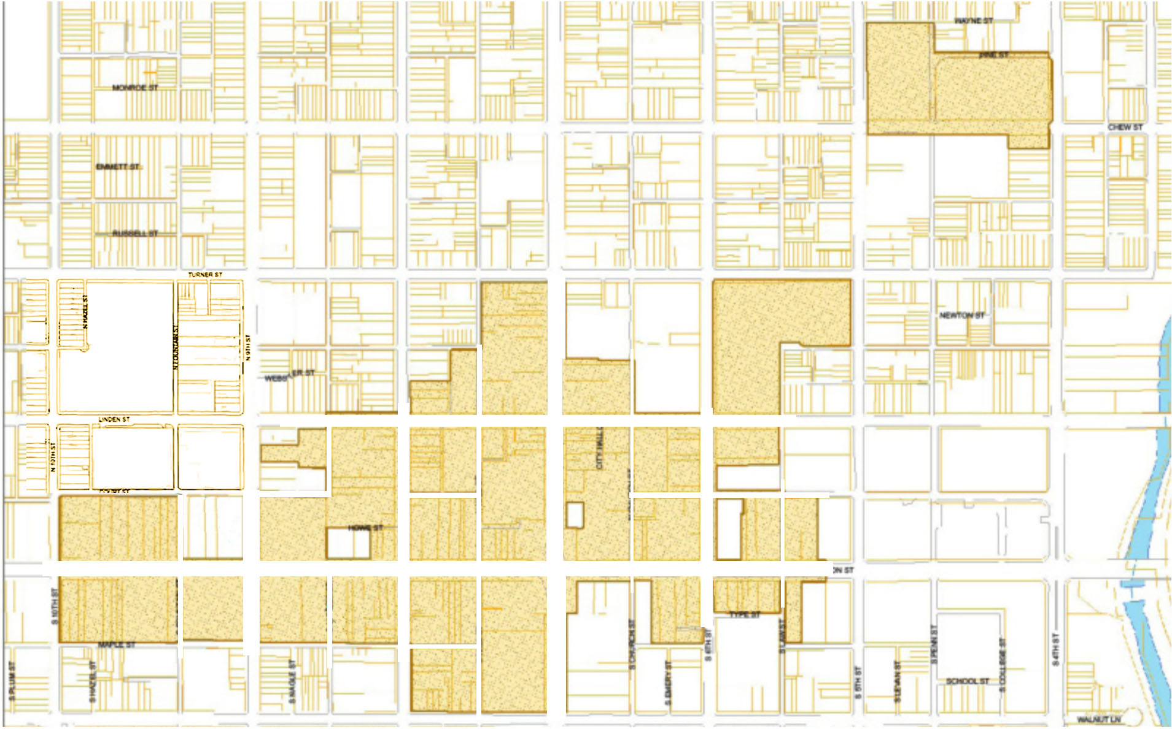
Map of DOWNTOWN niz
Finite Area with Limited Future Development Capacity +/– 40 Acres

Slide 4
Downtown NIZ Sites NOT AVAILABLE FOR FURTHER COMMERCIAL DEVELOPMENT
Existing Development
Future Commercial Development
Future Retail/Residential Development
Potential NIZ Property for Development
Sacred Heart Hospital
Morning Call
Retail/Resi
Verizon
Retail/Resi
Hess’s Parking Deck
Retail/Resi
Parking
Arena Block
Cosmo
PPL Plaza
City Center Office Site
Sovereign
Holiday Inn
Butz
Building
BrewWorks
City Center Office Site

Slide 5
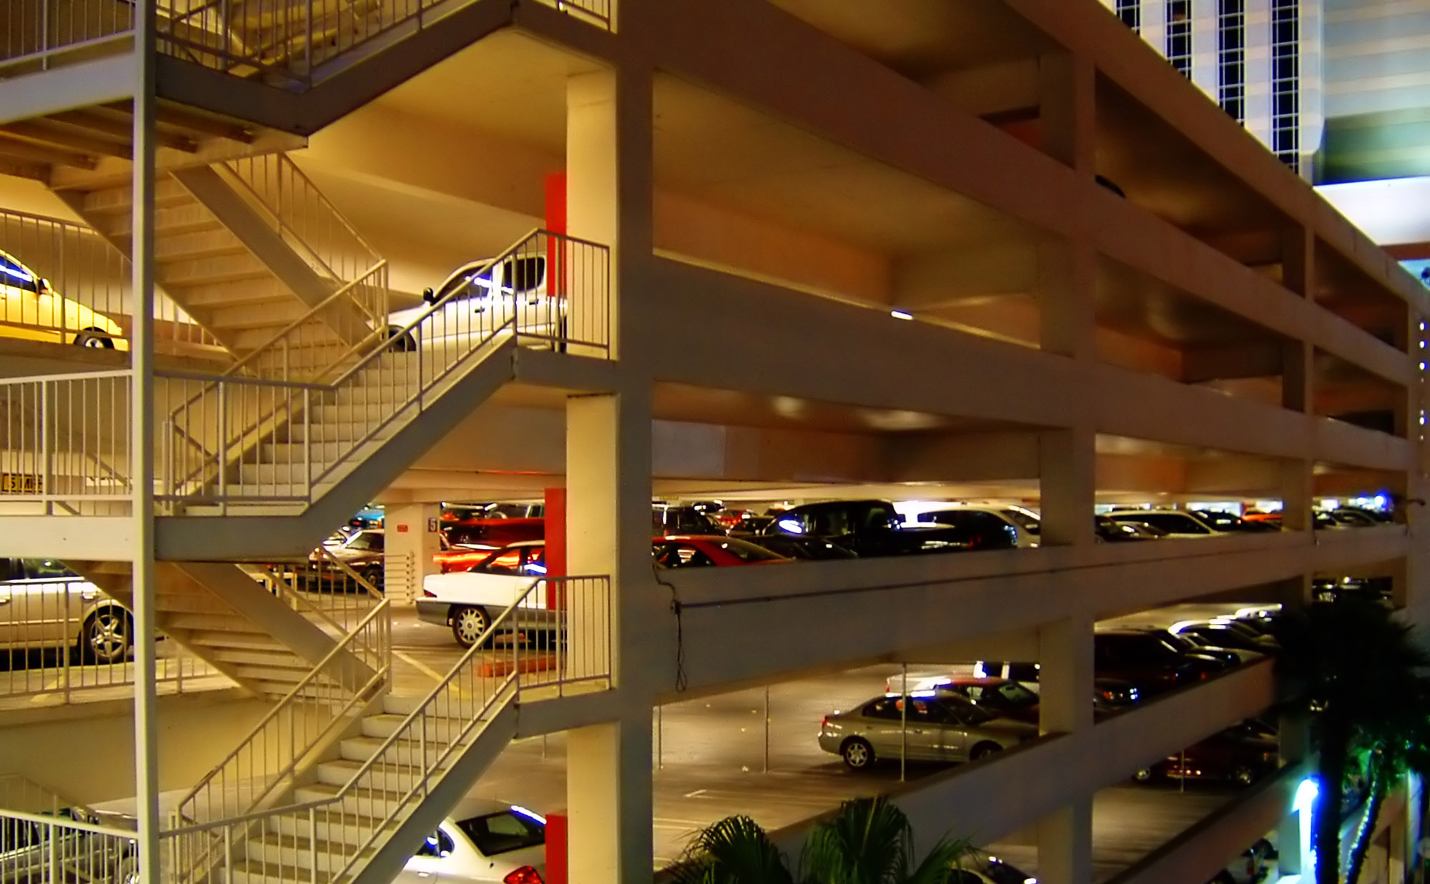
DOWNTOWN NIZ CHALLENGES
Incremental Costs for Urban NIZ Development:
Structured Parking
Increased Security During and After Construction
Prevailing Wage Construction Contracts
Higher General Construction Costs

Slide 6
DOWNTOWN NEEDS REVITALIZATION
Largest Urban Core in the Valley
Highest Poverty Rate in Allentown
Highest Unemployment in Allentown

Slide 7
Regional benefits
2,500+ Arena-block Jobs Created
1,700 Construction Jobs
750+ New Permanent Jobs

Slide 8
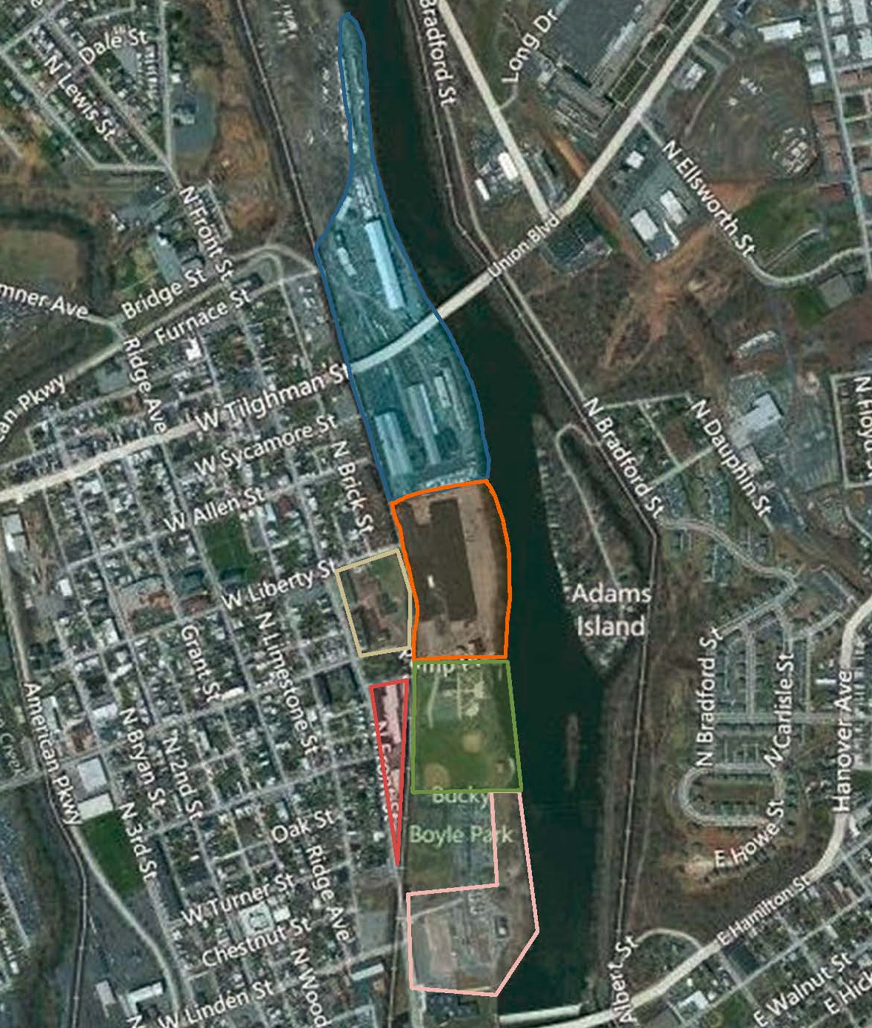
MAP OF RIVERFRONT NIZ
Existing Leases Limit Short-term Development Opportunities
15 Acres Buildable
Finite Area of +/–90 Acres
Long-term Leases
Bucky Boyle Park
PPL Substation

Slide 9
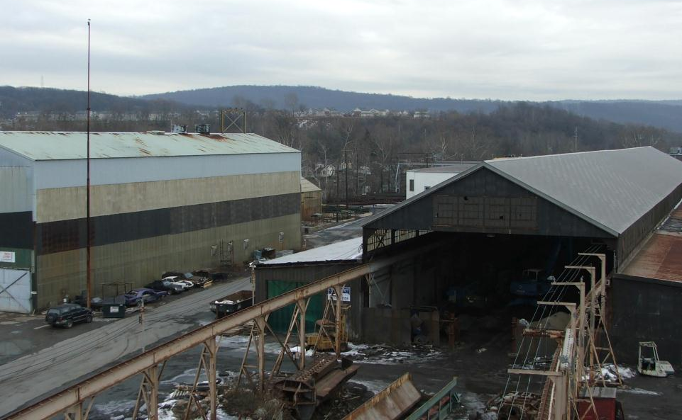
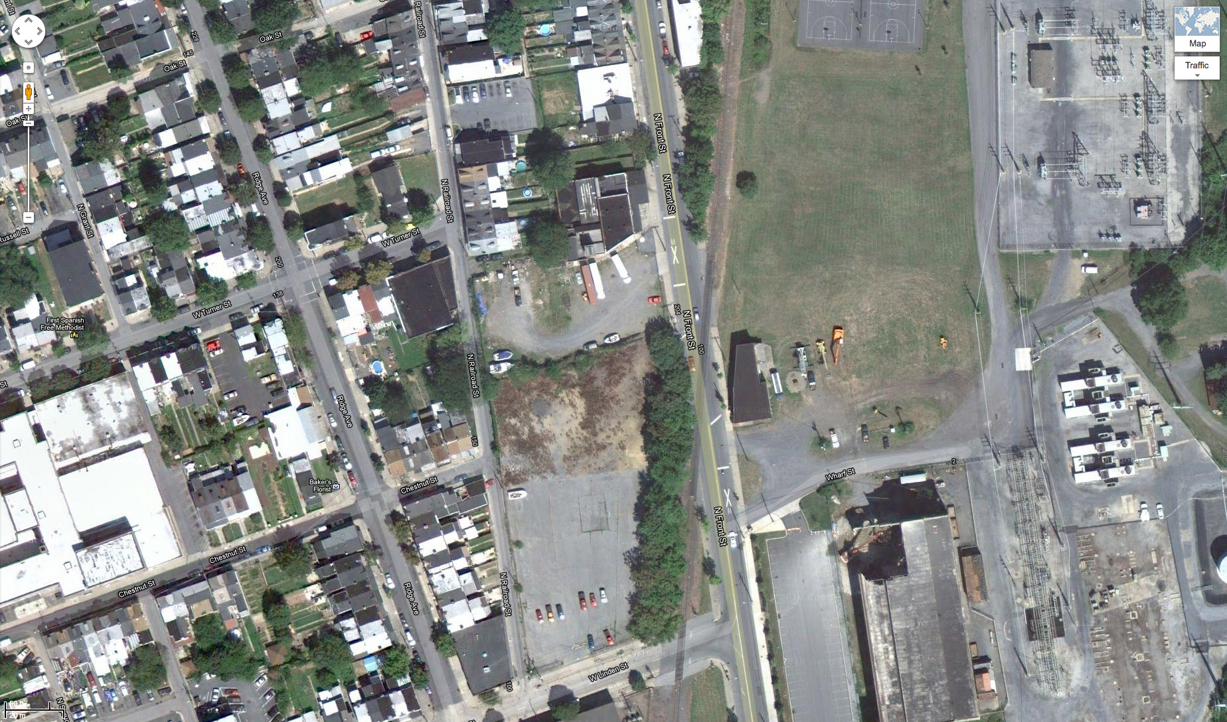
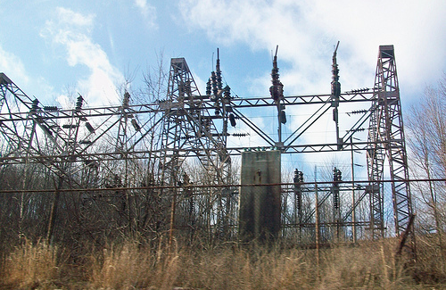
RIVERFRONT NIZ CHALLENGES
PPL Substation – $40 Million to Relocate
Bucky Boyle Park – Subject to Federal Restrictions
Several Buildings with Long-term Leases Up to 2022
Poor Access
Limited Development Opportunities Short-to-Midterm
Railroad Intersects Site
Heavy Industrial Use = Possible Environmental Remediation Required

Slide 10
THE NIZ IN CONTEXT OF THE BIG PICTURE
The NIZ Encompasses Finite and Challenging Development Opportunities.
The NIZ is Not Large Enough to Have Material Impact on Lehigh Valley’s Commercial Real Estate Market.
The NIZ is Necessary to Create a Healthy Urban Core & More Successful Region.

